Slide 1
2019 Influenza Updates
(Ventura County IZ Update)
Steven Vantine
Educational Consultant
State of California, Dept. of Public Health
Division of Communicable Disease Control
Immunization Branch
Version 2: 01.28.19kh/rs

Slide 2
Disclosures
Speaker has no financial conflict with manufacturers of any product named in this presentation. The use of trade names and commercial sources during this presentation is for identification only, and does not imply endorsement by the U.S. Department of Health and Human Services, the U.S. Public Health Service, the Centers for Disease Control and Prevention or the State of California, Immunization Branch.

Slide 3
Overview
Influenza disease
2018-2019 Influenza Recommendations
Disease burden
Shoulder – related injuries
Strategies for offering influenza vaccine
Provider flu resources

Slide 4
2018 – 2019 Influenza Season

Slide 6
Influenza Disease

Slide 7
Influenza Disease
Spectrum from mild to severe illness, including hospitalization or death
Increased risk of severe influenza
Extremes of age – oldest and youngest
Underlying conditions, including pregnancy
https://www.cdc.gov/flu/
https://www.cdc.gov/flu/about/index.html

Slide 8
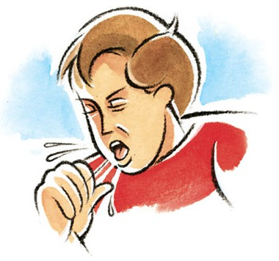
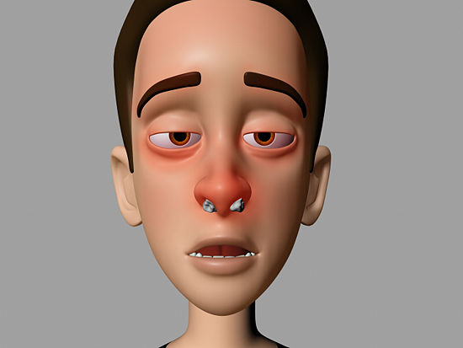
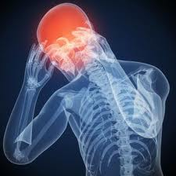
Signs and Symptoms May Include
Fever
Cough
Sore throat
Runny nose
Muscle or body aches
Headaches
Extreme fatigue
Vomiting and diarrhea, mostly in children
https://www.cdc.gov/flu/
https://www.cdc.gov/flu/about/index.html

Slide 9
Complications May Include
Ear infections
Sinus infections
Secondary pneumonia
Dehydration
Worsening of asthma, congestive heart failure, or other chronic conditions
Myocarditis
Encephalitis
Myositis, rhabdomyolysis
Multi-organ failure
Sepsis
https://www.cdc.gov/flu/
https://www.cdc.gov/flu/about/index.html

Slide 10
Prevention
Annual Immunization!
Everyday steps:
Stay away from people who are sick
Stay home if you are ill
Covering coughs and sneezes
Frequent and proper handwashing
https://www.cdc.gov/flu/
https://www.cdc.gov/flu/about/index.html

Slide 11
ACIP/CDC 2018 – 2019 Influenza Recommendations

Slide 12
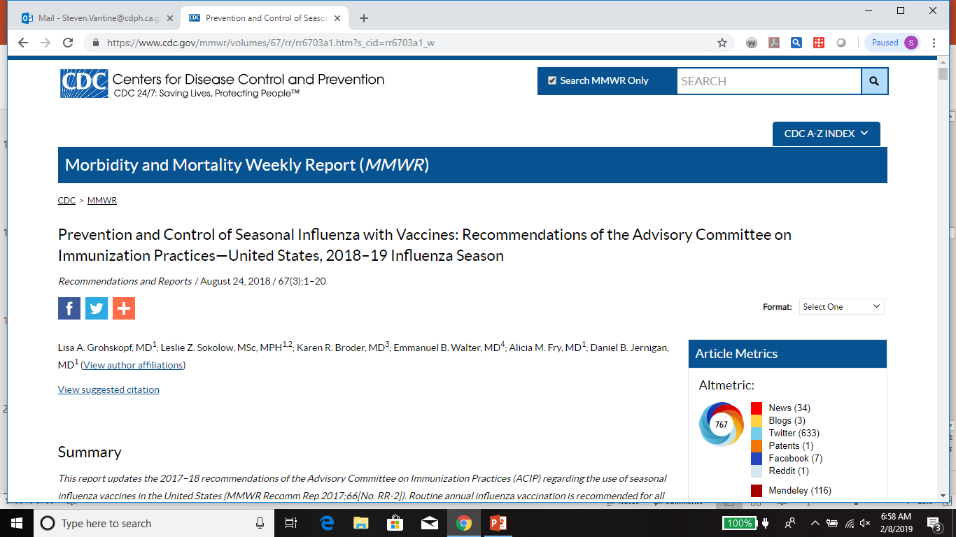

Slide 13
2018 – 2019 Flu Vaccine Composition
It is recommended that trivalent vaccines for use in the 2018-2019 northern hemisphere influenza season contain the following:
an A/Michigan/45/2015 (H1N1)pdm09–like virus,
an A/Singapore/INFIMH-16-0019/2016 (H3N2)–like virus, and
a B/Colorado/06/2017–like virus (Victoria lineage).
It is recommended that quadrivalent vaccines containing two influenza B viruses contain the above three viruses and a B/Phuket/3073/2013-like virus.
https://www.cdc.gov/mmwr/volumes/67/rr/rr6703a1.html

Slide 14
Updated Flu vaccination information
Vaccination providers may choose to administer any licensed, age-appropriate influenza vaccine (IIV, RIV4, or LAIV4). LAIV4 is an option for those for whom it is appropriate.
Persons with a history of egg allergy of any severity may receive any licensed, recommended, and age-appropriate influenza vaccine (IIV, RIV4, or LAIV4).
Expansion of the age indication for Afluria Quadrivalent (IIV4) from ≥18 years to ≥5 years
And expansion of the age indication for Fluarix Quadrivalent (IIV4), previously licensed for ≥3 years, to ≥6 months.
https://www.cdc.gov/flu/professionals/acip/index.html

Slide 15
2018 – 2019 Flu Vaccination Recommendations
Routine annual influenza vaccination is recommended for all persons aged ≥6 months who do not have contraindications.
A licensed, age-appropriate influenza vaccine (IIV, RIV4, or LAIV4) should be used.
Emphasis should be placed on vaccination of high-risk groups and their contacts/caregivers. When vaccine supply is limited, vaccination efforts should focus on delivering vaccination to:
Children aged 6–59 months;
Adults aged ≥50 years;
https://www.cdc.gov/mmwr/volumes/67/rr/rr6703a1.html
Notes:
Consult package information for age indications.

Slide 16
2018 – 2019 Flu Vaccination Recommendations
Vaccination of high-risk groups and their contacts/caregivers (cont.):
Persons with chronic pulmonary (including asthma), cardiovascular (excluding isolated hypertension), renal, hepatic, neurologic, hematologic, or metabolic disorders (including diabetes mellitus);
Persons who are immunocompromised due to any cause, (including medications or HIV infection);
Women who are or will be pregnant during the influenza season;
Children and adolescents (aged 6 months through 18 years) receiving aspirin- or salicylate-containing medications and who might be at risk for Reye syndrome;
Residents of nursing homes and other long-term care facilities;
American Indians/Alaska Natives;
https://www.cdc.gov/mmwr/volumes/67/rr/rr6703a1.html

Slide 17
Special Populations
Persons who live with or care for persons at higher risk for influenza-related complications
Health care personnel, in inpatient and outpatient-care settings, medical emergency-response workers
Employees of nursing home and long-term care facilities
Students in medical/nursing professions who will have contact with patients.
Household contacts (including children) and caregivers of children aged ≤59 months and adults aged ≥50 years
https://www.cdc.gov/mmwr/volumes/67/rr/rr6703a1.html
*https://www.cdc.gov/mmwr/volumes/66/rr/rr6602a1.htm (from 2017-2018 Recommendations)
Notes:
including physicians, nurses, and other workers
(e.g., paramedics and emergency medical technicians)

Slide 18
Live attenuated influenza vaccine (LAIV)
LAIV returns as an option for 2018-2019 influenza season
Was not recommended in US in recent seasons after concern about its effectiveness against H1N1 strains prior to 2016
Newer 2017-18 (A/Slovenia) vs. older 2015-16 (A/Bolivia) H1N1 strains
Increased reproduction in human cells, more immunogenic
2017-2018 season in UK – LAIV estimated to be 90% (CI 16-96%) effective in children 2-17 years of age
License indication unchanged: healthy, 2-49 years of age
https://www.cdc.gov/mmwr/volumes/67/rr/rr6703a1.html
https://www.cdc.gov/mmwr/volumes/67/wr/mm6722a5.htm

Slide 19
Pregnancy and flu vaccination

Slide 20
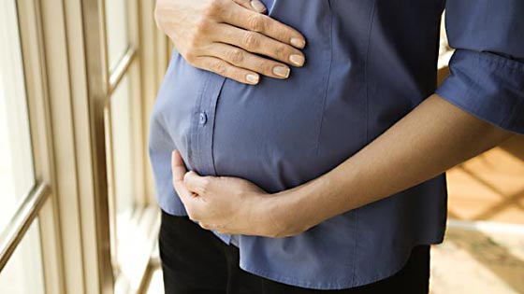
Pregnant women
2004 - present: Inactivated influenza vaccine recommended for women who will be pregnant during influenza season
Increased risk for severe influenza, especially during second and third trimesters or with H1N1 disease
Immunization during pregnancy helps protect both mother and young infants
https://www.cdc.gov/mmwr/volumes/67/rr/rr6703a1.html
*https://www.cdc.gov/mmwr/volumes/66/rr/rr6602a1.htm (from 2017-2018 Recommendations)

Slide 21
2018 – 2019 Flu Vaccination Recommendations
Children aged 6 months through 8 years who require 2 doses (see "Vaccine Dose Considerations for Children Aged 6 Months through 8 Years") should receive their first dose as soon as possible after vaccine becomes available, and the second dose ≥4 weeks later.
To avoid missed opportunities for vaccination, providers should offer vaccination during routine health care visits and hospitalizations when vaccine is available.
https://www.cdc.gov/mmwr/volumes/67/rr/rr6703a1.html

Slide 22
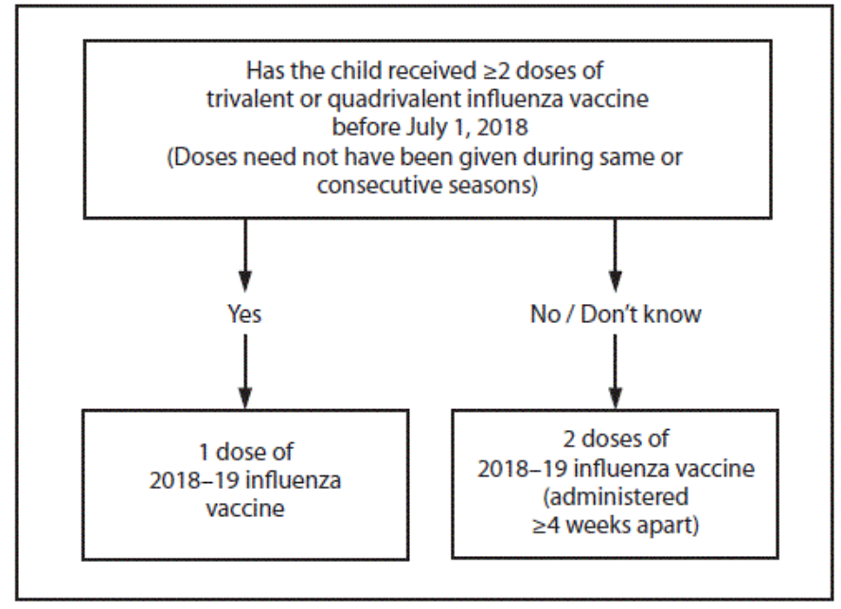
https://www.cdc.gov/mmwr/volumes/67/rr/rr6703a1.htm?s_cid=rr6703a1_w

Slide 23
Infants and toddlers – Dose varies by formulation
http://eziz.org/assets/docs/IMM-859.pdf

Slide 24
Infants and toddlers – Dose varies by formulation
http://eziz.org/assets/docs/IMM-859.pdf

Slide 25
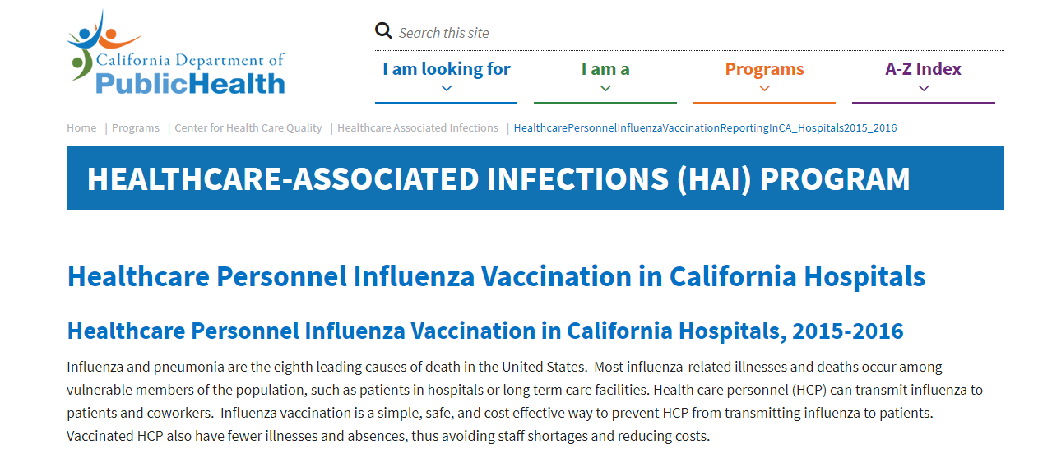
Flu Vaccination – California Healthcare Personnel

Slide 26
Flu Vaccination – California Healthcare Personnel
Most influenza-related illnesses and deaths occur among vulnerable members of the population, such as patients in hospitals or long term care facilities.
Health care personnel (HCP) can transmit influenza to patients and coworkers.
Influenza vaccination is a simple, safe, and cost effective way to prevent HCP from transmitting influenza to patients.
Vaccinated HCP also have fewer illnesses and absences, thus avoiding staff shortages and reducing costs.
https://www.cdph.ca.gov/Programs/CHCQ/HAI/Pages/HealthcarePersonnelInfluenzaVaccinationReportingInCA_Hospitals2015_2016.aspx

Slide 27
Flu Vaccination – California Healthcare Personnel
California acute care hospitals are required to offer free influenza vaccine to HCP.
Hospital HCP must receive an annual vaccine or sign a declination form.
Hospitals collect vaccination data for all HCP physically working in the hospital for at least one day during influenza season, regardless of clinical responsibility or patient contact.
Hospitals report HCP vaccination rates to the California Department of Public Health (CDPH) and CDPH publishes the hospital results annually.
https://www.cdph.ca.gov/Programs/CHCQ/HAI/Pages/HealthcarePersonnelInfluenzaVaccinationReportingInCA_Hospitals2015_2016.aspx

Slide 28
Disease Burden

Slide 29
2018-2019 Seasonal Influenza

Slide 30
2018-2019 Seasonal Influenza
https://www.cdc.gov/flu/weekly/index.htm#ILIMap

Slide 31
2018-2019 Seasonal Influenza
https://www.cdc.gov/flu/weekly/index.htm#ILIMap

Slide 32
2018-2019 Seasonal Influenza
https://www.cdc.gov/flu/weekly/index.htm#ILIMap

Slide 33
https://www.cdph.ca.gov/Programs/CID/DCDC/CDPH%20Document%20Library/Immunization/Week2018-1904_FINALReport.pdf

Slide 34
https://www.cdph.ca.gov/Programs/CID/DCDC/CDPH%20Document%20Library/Immunization/Week2018-1904_FINALReport.pdf
https://www.cdph.ca.gov/Programs/CID/DCDC/CDPH%20Document%20Library/Immunization/Week2017-1820_FINALReport.pdf

Slide 35
https://www.cdph.ca.gov/Programs/CID/DCDC/CDPH%20Document%20Library/Immunization/Week2018-1904_FINALReport.pdf
Notes:
Percentage of H3N2 93% match
Percentage of B-Victoria 24% match

Slide 36
Infants and toddlers – Dose varies by formulation
http://eziz.org/assets/docs/IMM-859.pdf

Slide 37
Shoulder-related injuries

Slide 38
Shoulder-related Injuries after injection
Notes:
Shoulder Injury Related to Vaccine Administration is thought to result from the unintentional injection of a vaccine into tissues and structures lying underneath the deltoid muscle of the shoulder. •
The Institute of Medicine (IOM) reviewed the scientific and medical literature finding that the evidence convincingly supported a causal relationship between vaccine administration and deltoid bursitis. •
Atanasoff et al. published a case series reporting the experience of the Vaccine Injury Compensation Program with regard to shoulder injuries following vaccination. The IOM reviewed this article and commented that the cases were consistent with deltoid bursitis

Slide 39
Shoulder-related Injuries after injection
Shoulder injury related to vaccine administration (SIRVA) manifests as shoulder pain and limited range of motion occurring after the administration of a vaccine intended for IM administration in the upper arm
Symptoms are thought to occur as a result of unintended injection of vaccine antigen or trauma from the needle into and around the underlying bursa of the shoulder
Reports to VAERS of shoulder dysfunction following IIV ranged from 128- 223 during the six influenza seasons from 2010-2011 to 2015-2016
https://www.cdc.gov/vaccines/acip/meetings/downloads/slides-2017-10/vaccine-safety-03-shimabukuro-508.pdf
Notes:
Shoulder injury related to vaccine administration (SIRVA) manifests as shoulder pain and limited range of motion occurring after the administration of a vaccine intended for intramuscular administration in the upper arm
These symptoms are thought to occur as a result of unintended injection of vaccine antigen or trauma from the needle into and around the underlying bursa of the shoulder resulting in an inflammatory reaction
Reports to VAERS of shoulder dysfunction following IIV ranged from 128- 223 during the six influenza seasons from 2010-2011 to 2015-2016 – During that period around 130 million doses of IIV were distributed each influenza season in the United States

Slide 40
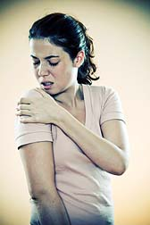
Shoulder-related Injuries after injection
When possible contributing factors were described, vaccination given too high on the arm was most commonly reported.
The most common place of vaccination documented in reports was in pharmacies/drug stores and doctor’s offices/hospitals
https://www.cdc.gov/vaccines/acip/meetings/downloads/slides-2017-10/vaccine-safety-03-shimabukuro-508.pdf
Notes:
When possible contributing factors were described, vaccination given too high on the arm was most commonly reported.
The most common place of vaccination documented in reports was in pharmacies/drug stores and doctor’s offices/hospitals

Slide 41
Shoulder-related Injuries after injection
Summary:
Improperly placed IIV (or any injectable vaccination) has the potential to cause shoulder injury
Proper administration technique is important
Training in proper injection technique is essential
Practicing proper injection technique is critical
CDPH offers an in-person training called Immunization Skills Institute (ISI)
https://www.cdc.gov/vaccines/acip/meetings/downloads/slides-2017-10/vaccine-safety-03-shimabukuro-508.pdf
Notes:
Summary:
Improperly placed IIV (or any injectable vaccination) has the potential to cause shoulder injury
Proper administration technique is important
Training in proper injection technique is essential
Parcticing proper injection technique is critical
CDPH offers an in-person training called Immunization Skills Institute (ISI)

Slide 42
Strategies for offering Influenza Vaccine

Slide 43
Talking with Parents about Flu Vaccine
Doctors, nurses, physician assistants, and office staff all play a key role in establishing and maintaining a practice-wide commitment to communicating effectively about vaccines and maintaining high vaccination rates.
You can all answer parents’ questions, provide educational materials, and ensure that families make and keep vaccine appointments.
https://www.cdc.gov/vaccines/hcp/conversations/talking-with-parents.html
Notes:
Doctors, nurses, physician assistants, and office staff all play a key role in establishing and maintaining a practice-wide commitment to communicating effectively about vaccines and maintaining high vaccination rates.
You can all answer parents’ questions, provide educational materials, and ensure that families make and keep vaccine appointments.

Slide 44
Talking with Parents about Flu Vaccine
Parents consider their child’s healthcare professionals to be their most trusted source of information when it comes to vaccines.
This is true even for parents who are vaccine-hesitant or who have considered delaying one or more vaccines.
Therefore, you have a critical role in helping parents choose vaccines for their child.
https://www.cdc.gov/vaccines/hcp/conversations/talking-with-parents.html
Notes:
Parents consider their child’s healthcare professionals to be their most trusted source of information when it comes to vaccines.
This is true even for parents who are vaccine-hesitant or who have considered delaying one or more vaccines.
Therefore, you have a critical role in helping parents choose vaccines for their child

Slide 45
Talking with Parents about Flu Vaccine
https://www.cdc.gov/vaccines/hcp/conversations/talking-with-parents.html
Notes:
Review algorithm

Slide 46
Provider Influenza Resources

Slide 47
Provider Flu Resources
Providers can use the VFC website
www.eziz.org
2018-2019 Flu materials are available now
All materials are posted on the VFC website
Program emails will be sent out to providers
Remember: check the website for updates

Slide 48
Provider Flu Resources

Slide 49
Why we do what we do . . .

Slide 51
Questions?

Slide 52
Steven J. VanTine
Educational Consultant, Immunization Branch Division of Communicable Disease Control, Center for Infectious Diseases California Department of Public Health Office: 510.412.1593 Email: steven.vantine@cdph.ca.gov

